Slide 1

DEPARTMENT OF COMPUTER SCIENCE AND ENGINEERING
MEDICAL INSURANCE COST PREDICTION USING MACHINE LEARNING
Under the Guidance of
S.RAJESWARI
(GUEST FACULTY)
A.SIVA PRASAD (R191021 )

Slide 2
Outline
Introduction
Objective
Motivation
Related Works
Methodology
Workflow
Results and Experimental Analysis
Discussions and Conclusion
References

Slide 3
ABSTRACT
Introduction:
Predicting the cost of medical insurance is important for both insurance companies and their customers. This project uses machine learning to create a model that can help predict how much a person might have to pay for medical insurance. By using data about people's age, gender, weight,Body mass index(BMI) and other factors, we can make better predictions about insurance costs.

Slide 4
Features:
Machine Learning Models : Employing various machine learning models such as and linear regression for training and evaluating prediction performance.
Effectiveness Of Machine Learning : Demonstrating the effectiveness of machine learning techniques in medical insurance analysis, specifically in predicting insurance outcomes in dynamic medical environments .
Identification Of Key Factors : Identifying the key factors that influence the results of insurance , crucial for accurate prediction.

Slide 5
Insights Of Prediction Enhancement : Offering insights gained from the study to enhance prediction accuracy in unpredictable events like the medical , contributing to advancements in medical analytic.
Real-Time Scenario Evaluation : Conducting real time Scenario evaluations to assess the performance and reliability of the machine learning models in predicting insurance outcomes.
Stack
- Python
- Machine Learning
- Matplotlib , Seaborn , NumPy and Pandas
- Jupyter Notebook

Slide 6
Introduction
Overview
Predicts the outcome of insurance data.
Utilizes historical data and advanced machine learning techniques.
Aims to provide accurate and reliable predictions.
Benefits cost, analysts, insurance prediction.

Slide 7
Scope
Comprehensive Data Analysis: Utilizes extensive historical data, including insurance results, patients statistics, risk conditions, and more.
Machine Learning Techniques: Implements advanced algorithms such as linear regression., Gradient Boosting, SVM, and Neural Networks for accurate predictions.
Real-Time Updates: Capable of integrating real-time data during health issue to provide dynamic and up-to-date predictions.
User Engagement: Offers a user-friendly interface for teams, analysts, and users to access predictions and insights easily.
Strategic Insights: Provides valuable information for region , cost prediction

Slide 8
Objective
Improve Accuracy: Develop a highly accurate prediction model.
Key Factors: Identify crucial elements influencing insurance cost .
Real-time Predictions: Enable dynamic updates during insurance Predictions.
User-Friendly: Create an easy-to-use interface for various users.
Comprehensive Analysis: Cover all aspects influencing a predicting, such as region, health conditions, and age.

Slide 9
Motivation
Traditional methods are subjective and limited.
Machine learning processes vast data for better predictions.
Objective and data-driven approach enhances reliability.
Bridges the gap between raw data and actionable insights.

Slide 10
Literature
Introduction to Literature
Early Approaches: Initial methods for predicting insurance cost on basic statistical analysis for customer.
Shift to Machine Learning: The advent of machine learning brought more sophisticated models capable of analyzing vast datasets and identifying complex patterns.
Purpose: Review key studies and methodologies used in the prediction of insurance cost, specifically focusing on the age.

Slide 11
Insights and Emerging Trends
Data Quality: High-quality data is crucial for accurate predictions. Missing values, incorrect data entries, or outliers can significantly impact the model's performance.
Feature Importance: Understanding which features (e.g., age, BMI, smoking status) are most predictive of medical costs can provide valuable insights. Techniques like feature importance scores from tree-based models or SHAP values can help identify these key features.
Evaluation Metrics: Common metrics for regression tasks, such as R-squared, help evaluate model performance. Comparing these metrics across different models can reveal which algorithm performs best for this specific problem.

Slide 12
Contribution
Data Collection and Preprocessing:
Gathered a comprehensive dataset that includes various features relevant to predicting medical costs such as age, gender, BMI, number of children, smoking status, and region.
Performed thorough data cleaning and preprocessing to handle missing values, encode categorical variables, and scale numerical features.
2. Exploratory Data Analysis (EDA):
Conducted an in-depth analysis of the dataset to understand the distribution of features and their relationship with the target variable (medical costs).
insurance Advantage: More usefull for highly risk candidates

Slide 13
Age Conditions: More age give the high risk factors so insurance will be very high compare to others
Bmi Conditions: More BMI give the high risk factors so insurance will be very high compare to others
HEALTH CONDITION: Health is bad give the high risk factors so insurance will be very high compare to others
Child: More child give the high factors so high insurance will be very high compare to others

Slide 14
Methodologies:
Data Collection and Cleaning
Exploratory Data Analysis (EDA) and Feature Engineering
Model Selection and Training
Model Evaluation
Model Deployment and Visualization
Continuous Improvement

Slide 15
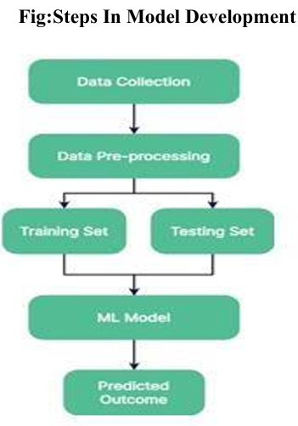
Fig: PROJECT PLAN

Slide 16
Data Collection and Cleaning
Collect insurance Data:
Gather past insurance details, including costs and results.
Collect customer Data:
Gather individual customer statistics, like BMI and AGE .
Collect Data:
Gather team performance records, including cost history.
Collect Data and health condition:
Gather information on health conditions and insurance .
Clean and Standardize Data:
Remove duplicates, handle missing values, and ensure consistency in format.

Slide 17
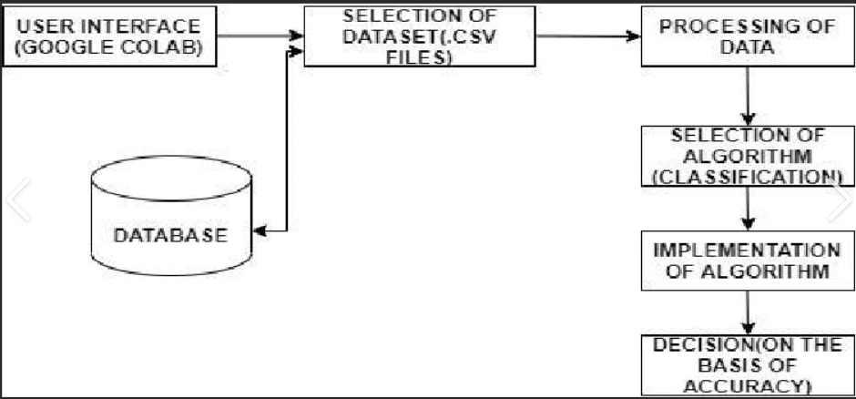
Fig: Steps to follow

Slide 18
Exploratory Data Analysis (EDA)
Understand Data Distribution:
Analyse data summaries like averages and ranges.
Identify how data is spread out.
Visualize Data:
Use charts and graphs (e.g., count plots) to spot patterns and trends.
Look for relationships between variables.
Detect Outliers:
Identify unusual data points that might affect predictions.
Investigate any anomalies found

Slide 19
Feature Engineering
Select Relevant Features:
Choose key data points what is the insurance for in certain age like that (e.g.,customer , health performance).
Create New Features:
Generate useful metrics (e.g., average cost, from the data set).
Standardize and prepare features for modeling.

Slide 20
Model Selection and Training
Choose Models:
Select appropriate machine learning algorithms (e.g., linear regression).
Consider ensemble methods for better accuracy.
Prepare Data:
Split data into training and testing sets.
Format data for training models.
Train Models:
Feed data into chosen models to learn patterns.
Adjust model parameters for better performance.

Slide 21
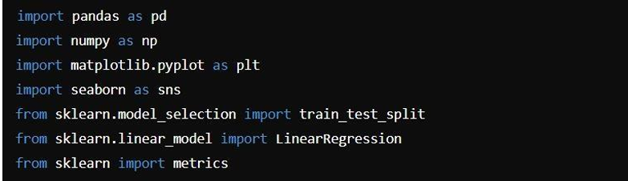
Fig: Importing Libraries

Slide 22

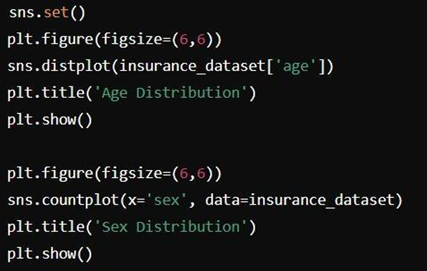
Fig : Data Loading
Fig : Data Preprocessing

Slide 23
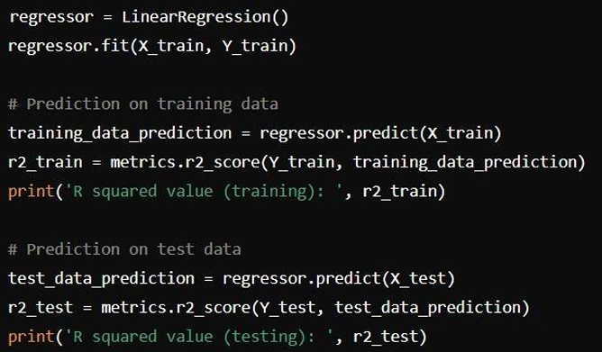
Fig: Training The Model

Slide 24
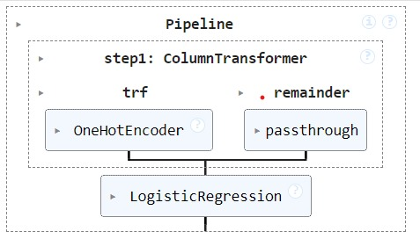
Fig: Logistic Regression

Slide 25
Evaluate Performance:
Use testing data to assess how well models predict outcomes.
Measure accuracy and other metrics to gauge performance.
Optimize :
Fine-tune models by adjusting parameters.
Use cross-validation to validate model robustness.
Finalize Model:
Select the best-performing model.
Prepare for deployment and future predictions

Slide 26
Model Evaluation
Use Testing Data:
Evaluate the model's predictions on a separate testing dataset.
Metrics:
Measure performance using metrics like accuracy, precision, recall,Rsquared
Cross-Validation:
Validate model consistency across different data subsets.
Compare and Select:
Compare models to choose the most accurate one for cost predictions.
Adjust for Accuracy:
Fine-tune the model based on evaluation results

Slide 27
Model Deployment and Visualization
Prepare Model for Deployment:
Finalize the trained model for operational use.
Ensure compatibility with deployment environments.
User Interface Development:
Create a user-friendly interface for inputting new data and receiving predictions.
Consider usability and accessibility.
Visualization of Predictions:
Develop visualizations (e.g., charts, graphs) to illustrate predicted outcomes.

Slide 28
Testing:
Conduct thorough testing of the deployed model and interface.
Verify accuracy and reliability of predictions in real-world scenarios.
Deployment:
Deploy the model and interface to production.
Monitor performance and gather feedback for continuous improvement.

Slide 29
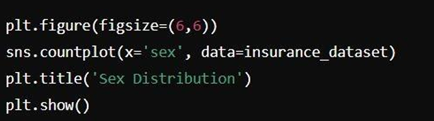
Fig: Data Visualisation

Slide 30
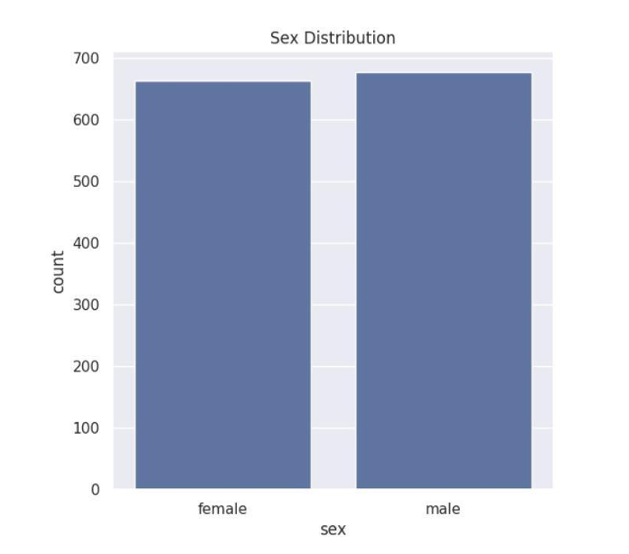
Fig: Team Performances

Slide 31
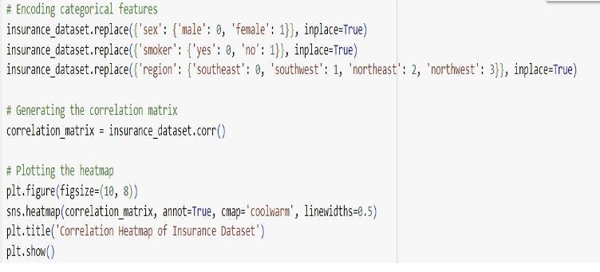
Fig: Correlation Heatmap of Insurance Dataset

Slide 32
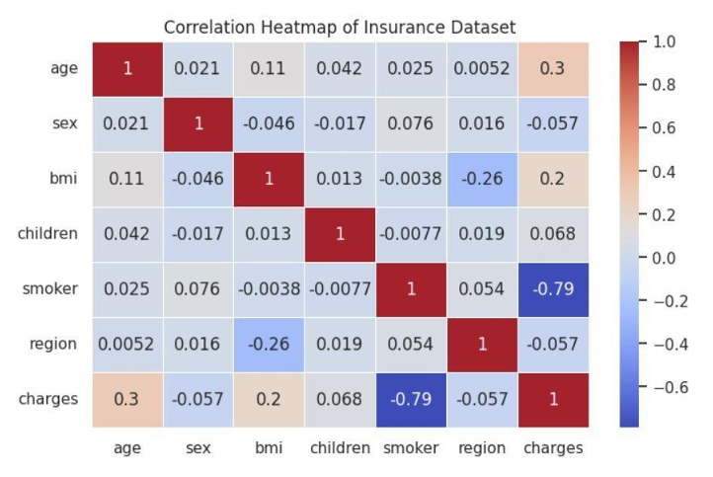

Slide 33
Continuous Improvement
Data Updates:
Regularly update model with new customer and cost data.
Ensure data remains current for accurate predictions.
Feedback Integration:
Incorporate user and stakeholder feedback to refine predictions.
Use feedback to identify and address areas for improvement.
Performance Monitoring:
Continuously monitor model performance.
Adjust model based on changes in prediction accuracy.
Refinement:
Refine algorithms and features to enhance prediction capabilities.

Slide 34
Conclusion and Future Enhancements
Effective Predictions: Using machine learning, we accurately predict the cost of the insurance.
Key Factors: Age performance, Child, Body mass index , region and for bmi height and weight.
Continuous Improvement: Regular updates and user feedback refine models, improving prediction accuracy.
Enhanced Insights: These predictions for customer, analysts, and cost prediction.
Future Developments: Advancements in data analysis and AI will further refine predictions, making them even more precise and valuable for other peoples

Slide 35
THANK YOU

